Slide 1
PROFOUND CODERS
VENUCHAITANYA DIGVIJAY SINGH TANWAR ABHISHEK NYATI

Slide 2
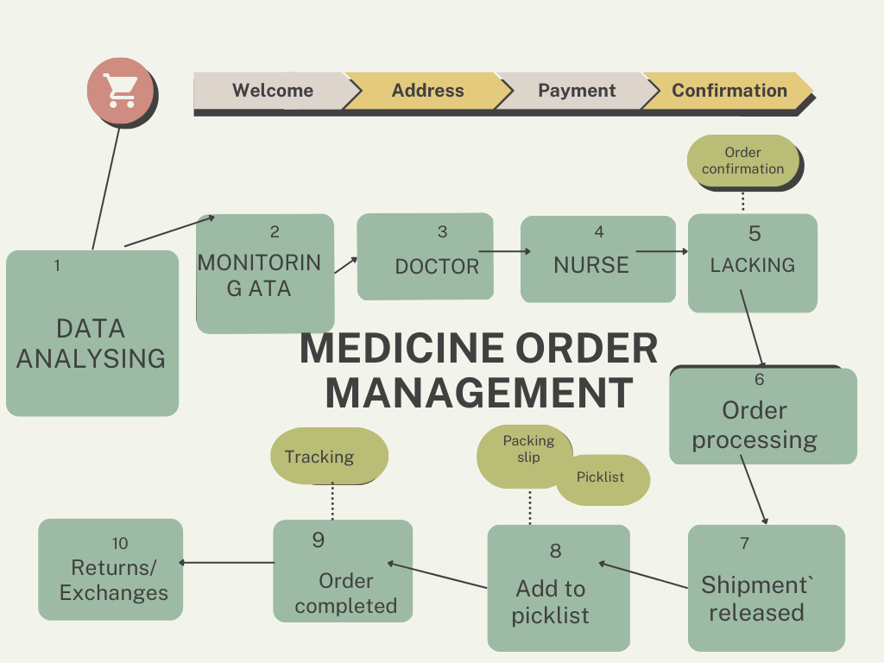

Slide 3
Because of expiry of medicines, delayed delivery(Causes damage to medicines), carrying medicines on low-temperature, Low-supply & High-demand, emergency-needs of Blood-bottles

Slide 4
SOLUTUONS
A proper supply management system is critical for the efficient and effective operation of a hospital. Here are some steps that can be taken to maintain such a system:

Slide 5
Technology used:

Slide 6
SOLUTUON 2
Establish a system for tracking inventory: A hospital should have a system in place for tracking inventory levels of medical supplies, equipment, and pharmaceuticals. This can be done manually or through the use of automated inventory management software.

Slide 7
SOLUTUON 3
Develop a procurement plan: The procurement plan should be based on the hospital's needs, budget, and patient volume. It should also take into account the lead time required for ordering and receiving supplies.

Slide 8
SOLUTUON 4
Maintain accurate records: The hospital should keep accurate records of all supplies received and used. This information can be used to identify trends, adjust procurement plans, and reduce waste.

Slide 9
SOLUTUON 5
Use a centralized storage system: A centralized storage system can help ensure that supplies are stored properly and are easily accessible to those who need them. It also makes it easier to track inventory levels and avoid stockouts.

Slide 10
SOLUTUON 6
Implement a system for identifying and disposing of expired or damaged supplies: Expired or damaged supplies can pose a risk to patients and staff. A system should be in place for identifying and disposing of these supplies safely.

Slide 11
SOLUTUON 7
Establish clear protocols for requesting and using supplies: Clear protocols should be established for requesting and using supplies to ensure that they are used appropriately and efficiently.

